Slide 1
Cereal Killer
Recipe Suggestion and Meal Planner Application
Maria Gloria Obono Ondo
Anay Rajesh Pampatwar
Brian Marcel Patrao
Vivek Murugan
Divya Shree

Slide 2
Contents
Introduction - Problem Definition
04
Demo
01
Approach to resolve the issue.
Big Learnings
02
05
System Design
Next Steps for the product.
03
06
Collab

Slide 3
Introduction
Problem Statement
Cooking daily three times a day is almost equivalent to a full time job and it’s hard for most of the people around the globe, especially students and working professionals to cook for themselves. Without any proper plan often students and working professionals cook for a day or two and then end up starving and eating fast food from outside on a daily basis which is not good for our health.
We usually also end up buying ingredients which we forget to use completely and it sits in the pantry until it gets spoiled.

Slide 4
CEREAL KILLER
Resolution
To resolve this problem we decided to come up with a Recipe Suggestion and Meal Planner Application called “CEREAL KILLER”. Cereal Killer is a JavaFX application that can be used to-
keep a record of all the items in your Pantry with it’s expiration date.
get suggestions of recipes that can be prepared with pantry items that you have.
see a detailed view of each recipe with all the ingredients and measure of each, cooking instructions and video of the recipe.
used to plan your meals a week ahead.

Slide 5
Tools and Technologies
Development Tools
Technical Skills
Eclipse IDE
Scene Builder
01
03
Java
JavaFX
Scene Builder
MySQL
SQL Workbench
Concepts
Management Tools
Classes and Objects
Inheritance
Interface
Array List
Set
Observable Lists
Trello Dashboard
Github
MS Teams
02
04

Slide 6
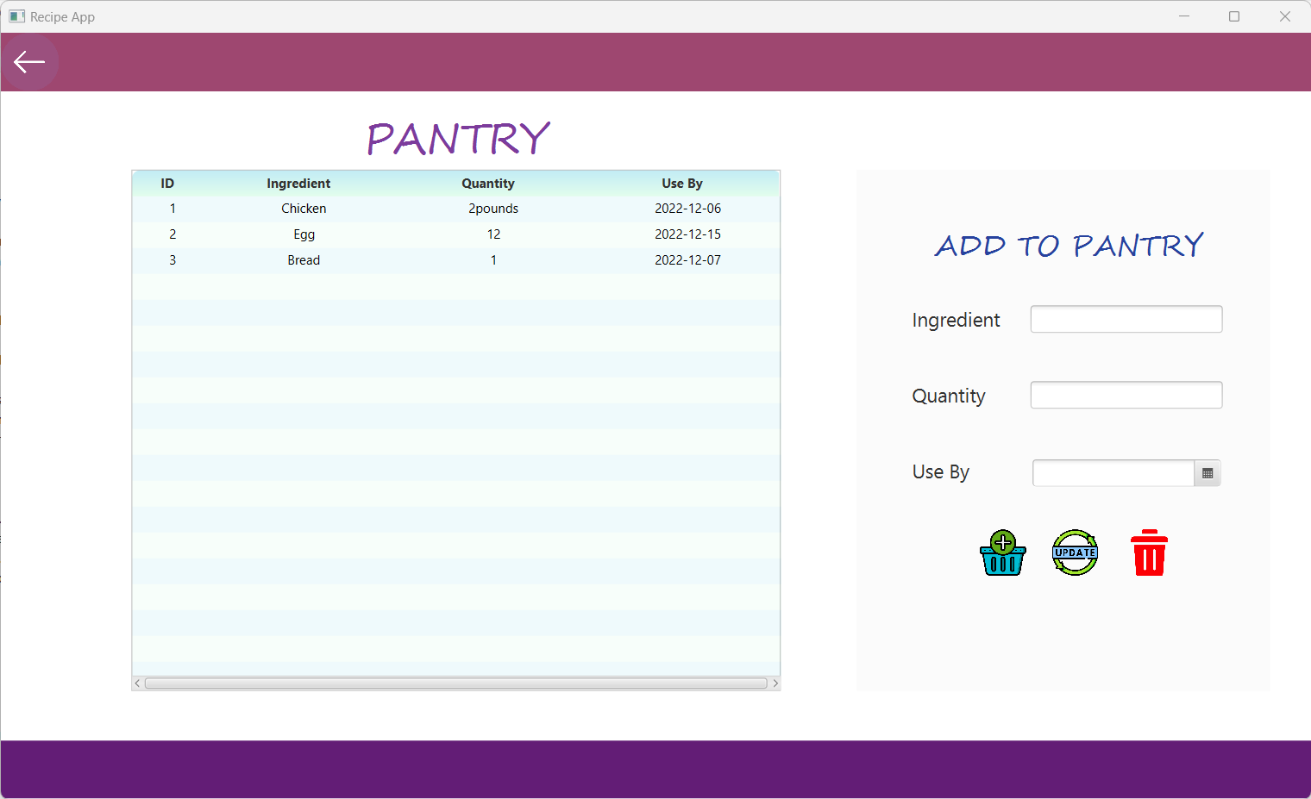
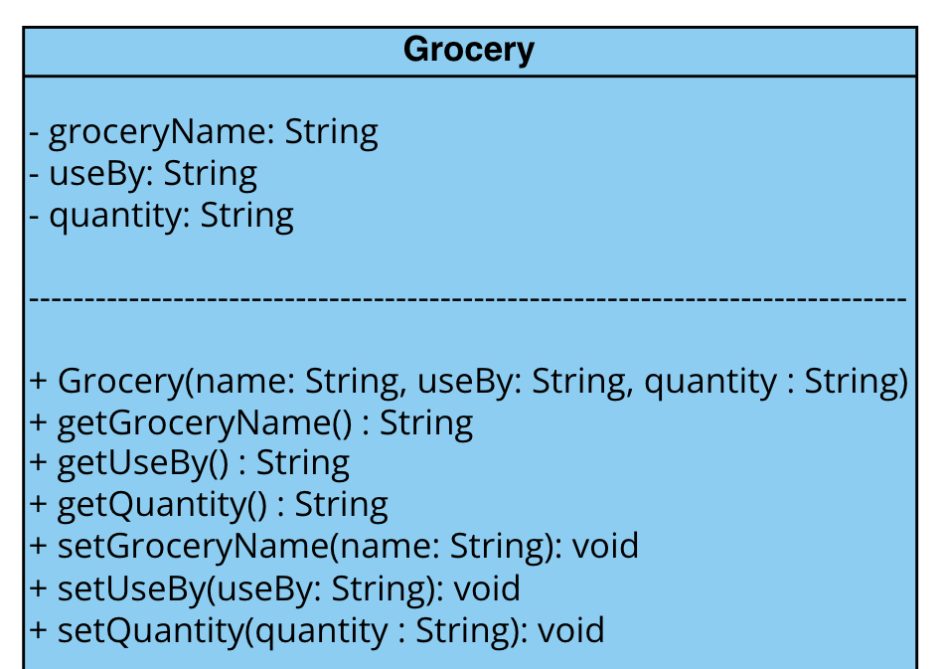
System Design
Scene 1 - Pantry Screen
This screen will show you what all groceries you have in your pantry.
It will also allow you to add, update and delete items in your pantry.
Database used: MySQL

Slide 7
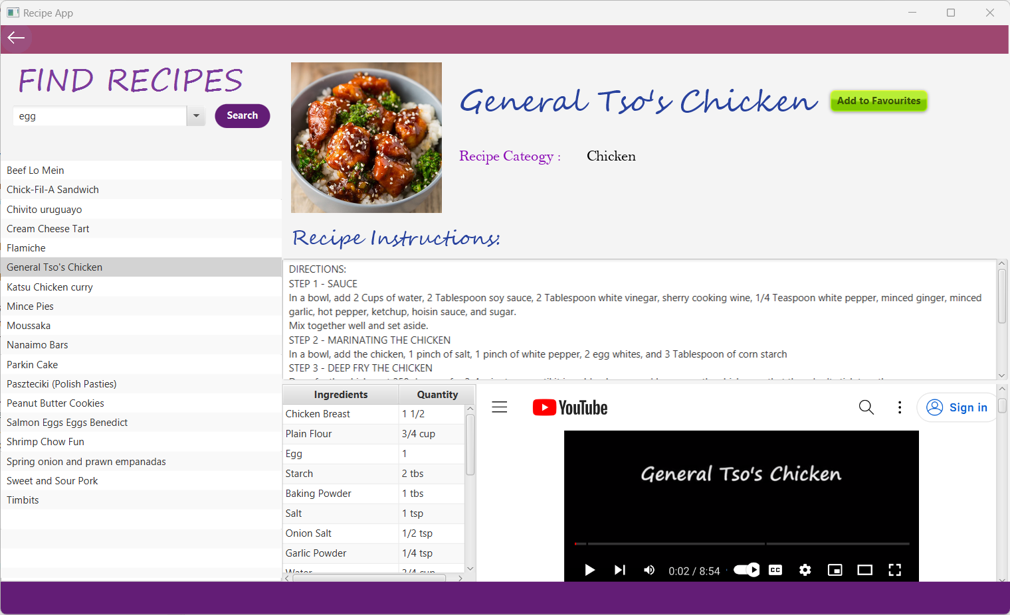
System Design Cont..
Scene 2 - Recipe Suggestion Screen
User can be able to search for recipes based on the ingredients he has in his pantry.
A list of recipes will be shown to the user to choose from. When user clicks on any recipe, a detailed view of the recipe will be shown.
This detailed view will consist of Recipe Name, Cooking Instructions, all the ingredients required and the recipe video also will be played in the screen.
To show the recipe suggestions, we have made use of TheMealDB Api
https://www.themealdb.com/api.php

Slide 8
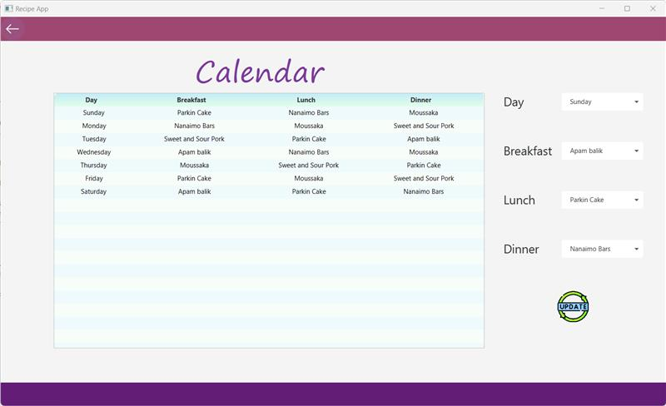
System Design Cont…
Scene 3 - Planner Screen
This screen will have a calendar view for a week with the meal chart. User can update their meal plan by selecting any day and from the list of favourite dishes that he added to his meal plan.
Database used: MySQL
Future Scope.

Slide 9
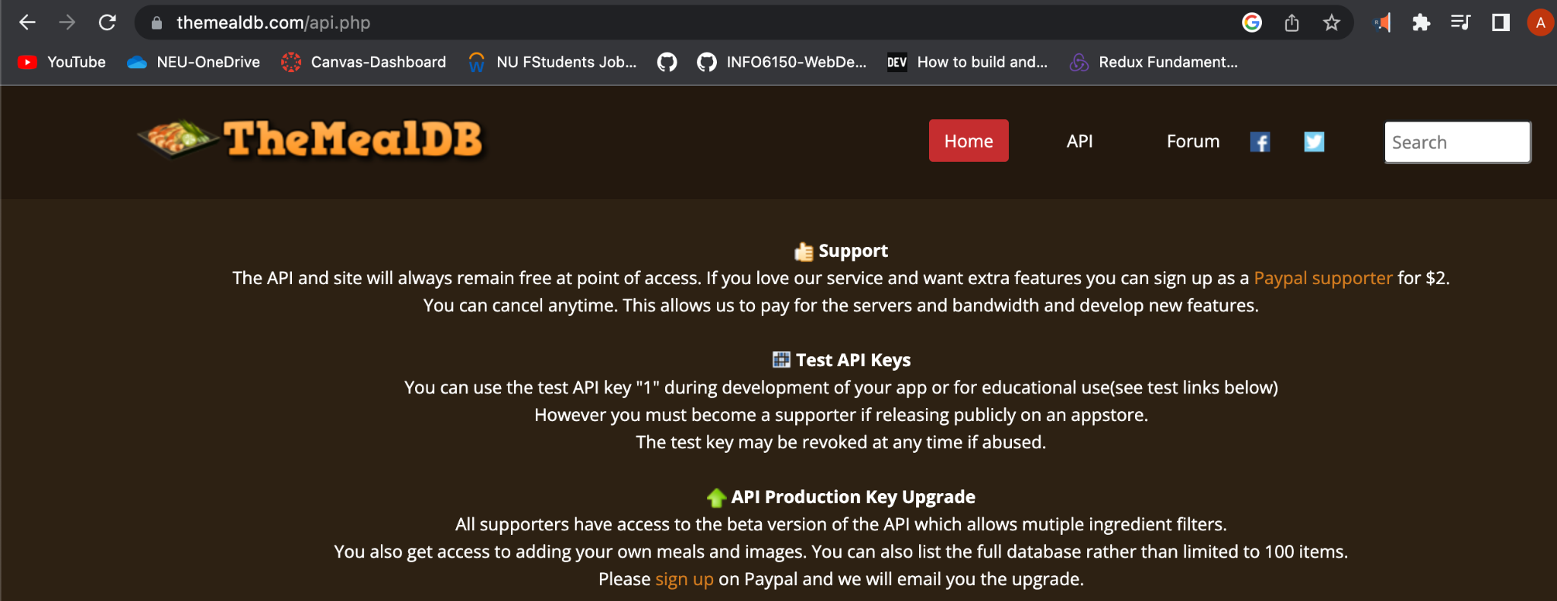
The Meal DB API
https://www.themealdb.com/api.php

Slide 10
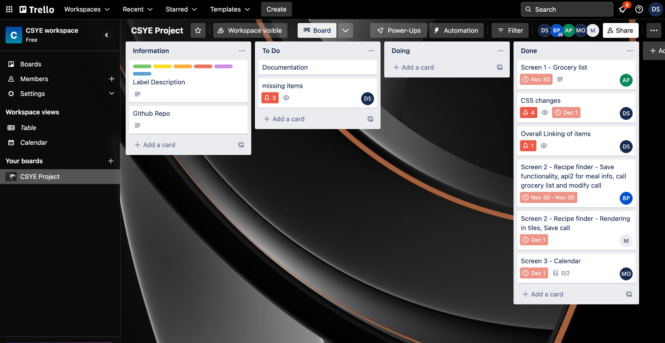
Collaborations
Trello
For assigning and tracking task progress
Mercury
Venus
Venus has an incredibly beautiful name and is the second planet
Jupiter
Planet Jupiter is the biggest object in the entire Solar System

Slide 11
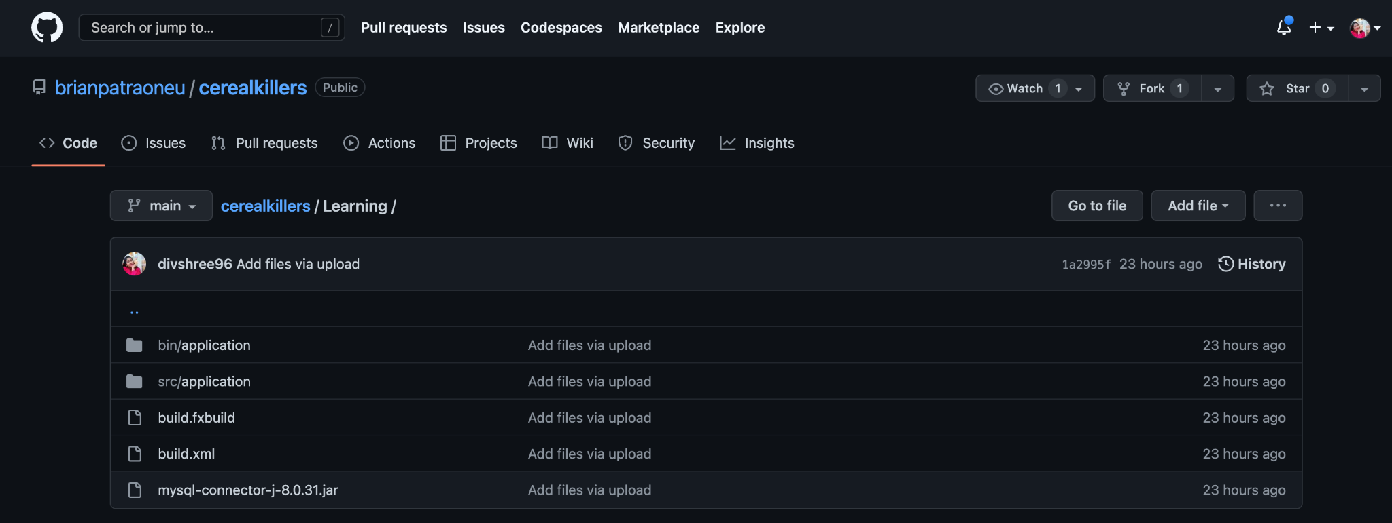
Code Collaboration
Github
We used github to push all our java code and share same jar files.

Slide 12
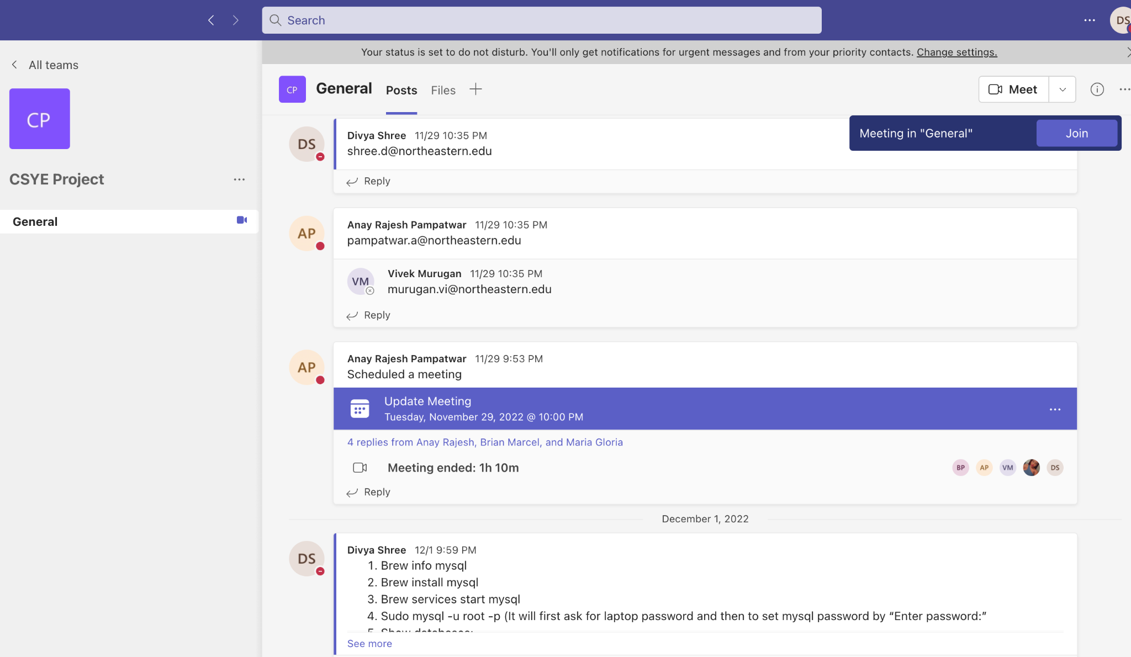
Team Collaboration
MS Teams
We used teams to regularly connect and discuss our issues and progress.

Slide 13
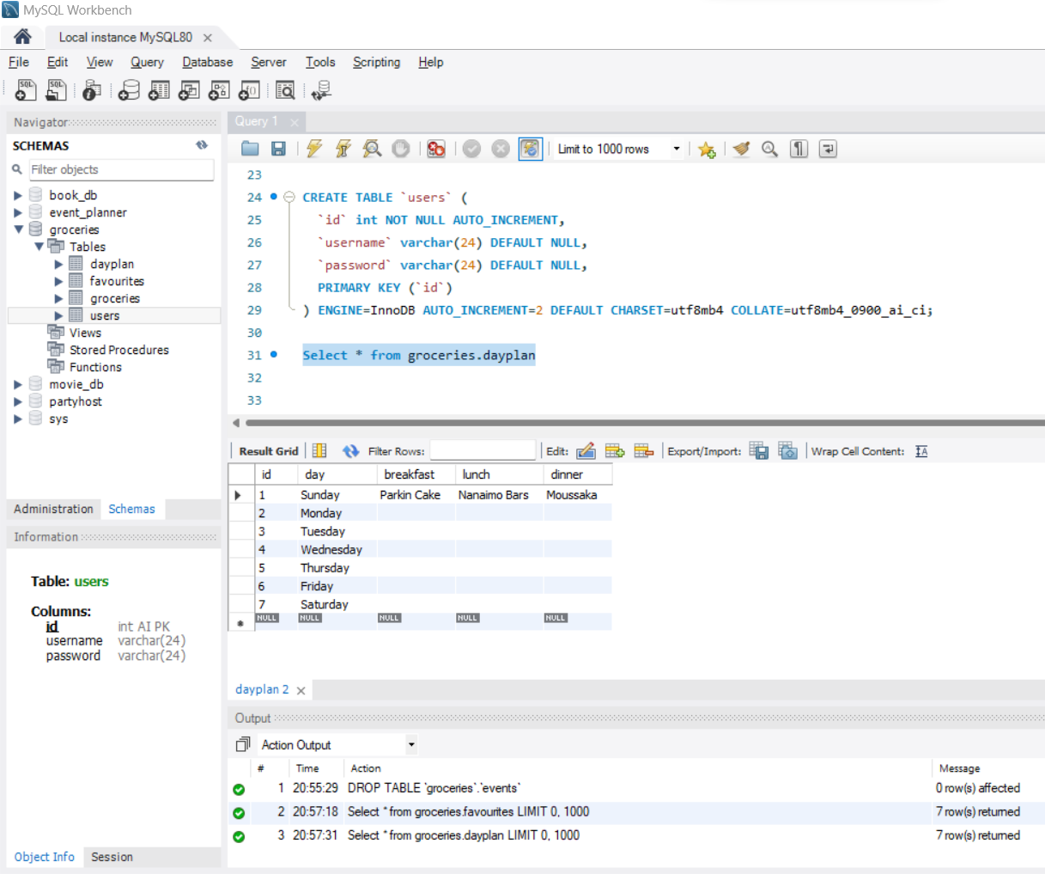
Database Tool
MySQL Workbench

Slide 14

Demo

Slide 15
Big Learnings
01
02
03
04
Learnt about various Java concepts like
Classes and objects, Abstract classes and interfaces, inheritance and polymorphism.
Increased proficiency in concepts like array lists, observable lists, and Hash Sets.
We also learnt event driven programming through different types of events like Action event, Mouse Event, etc. Design of our application using GUI features like combobox, imageview, table view, etc using Scene Builder for JavaFX application.
We also learnt how to connect Java application to a database (how to create a connection and incorporate CRUD operations on the data according to user actions).
We also learnt to design each component by writing custom CSS and attaching it as a resource for each FXML.
Learnt to effectively communicate, allocate tasks, resolve conflicts and work productively as a team.

Slide 16
NEXT STEPS FOR THE PRODUCT
The user can get a notification to prepare the next meal.
In the future, the user can export the weekly plan to his device calendar.
Step 4
Step 1
It will auto generate a list of suggested recipes on the basis of ingredients in the pantry.
Step 3
Step 2
A shopping list would be curated for the user on the basis of the plan and the available items in pantry.

Slide 17
Question???
Credits
This presentation template was used from SLIDESGO.

